Slide 1




Financial Forecasting Data Analysis using Excel
STUDENT NAME:S.KEERTHANA
REGISTER NO:422200032
DEPARTMENT:B.COM(ISM)
COLLEGE:S.I.V.E.T. COLLEGE

Slide 2

Financial Forecasting Data Analysis Using Excel

Slide 3


AGENDA
Problem Statement
Project Overview
End Users
Our Solution and Proposition
Dataset Description
Modelling Approach
Results and Discussion
Conclusion
3/21/2024 Annual Review

Slide 4
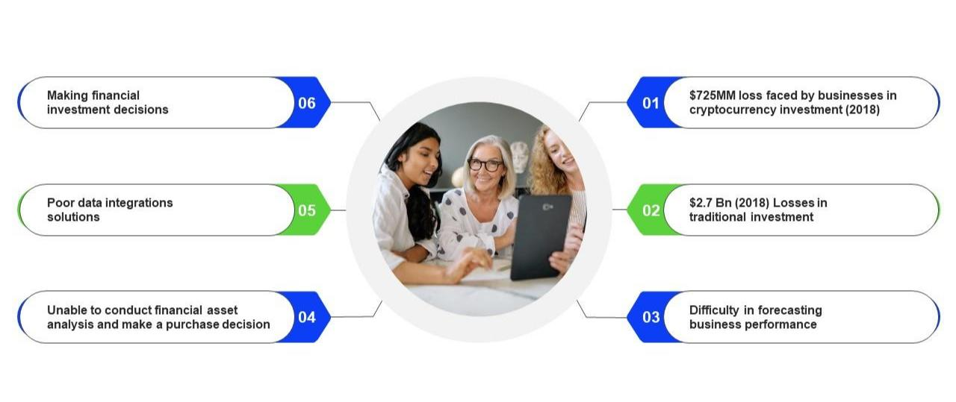

PROBLEM STATEMENT

Slide 5


PROJECT OVERVIEW
✓Financial Forecasting System project aims to
develop and implement a robust financial
forecasting model.
✓project forecasting is a vital part of project
management that helps predict a project's future
performance by analysing current data.it can help
project managers make informed decisions about
resource allocation,risk,management.
✓Clearly define the purpose of the financial forecasting
project, such as improving budgeting, predicting
revenue growth, or identifying cost savings
opportunities.
✓Outline the expected benefits of the financial
forecasting project, such as improved decision-making,
reduced costs, or increased revenue.

Slide 6


WHO ARE THE END USERS?
End users of financial forecasting includes: 1. CEO/MD (strategic decision-making) 2.CFO/Financial Director (financial planning, risk management) 3. Financial Planning & Analysis (FP&A) Team 4. Accounting and Finance Department 5. Budgeting and Treasury Team 6. Operational Managers (sales, marketing, production) 7. Strategic Planning Team 8. Risk Management Team

Slide 7

OUR SOLUTION AND ITS VALUE PROPOSITION
✓Value Proposition: Improve forecast accuracy, enhance
decision-making, and Advanced Financial Forecasting
Platform (AFFP). Our solution leverages AI-powered
algorithms, real-time data integration, and collaborative tools
. to deliver
✓Real-time data integration: Automatically import data from
ERP, CRM, and other systems.
✓Automated reporting: Generate customized reports and
dashboards for stakeholders.
✓Scenario planning: Easily create and manage multiple
scenarios to assess risks and opportunities.
Solution:Advanced Financial Forecasting Platform (AFFP)

Slide 8

Dataset Description
Dataset Name: Financial Forecasting
Dataset.
✓ This dataset contains
historical financial data and
corresponding forecasting targets,
designed for training and evaluating
financial forecasting models.
✓The Financial Forecasting Dataset
(FFD) is a comprehensive collection
of historical financial data from
various industries, designed to
support financial forecasting models.

Slide 9

THE "WOW" IN OUR SOLUTION
✓AI-Powered Forecasting:Leveraging machine learning
algorithms for unparalleled forecast accuracy.
✓Real-Time Data Integration: Seamless connection to various data sources
(ERP, CRM, financial statements)
✓Predictive Analytics: Identifying potential risks and opportunities through
advanced statistical models.
✓Automated Scenario Real-Time Data Integration: Seamless
connection to various data sources (ERP, CRM, financial
statements)
✓Collaborative Platform: Enabling multiple stakeholders to
contribute to forecasts.
3/21/2024 Annual Review
9

Slide 10
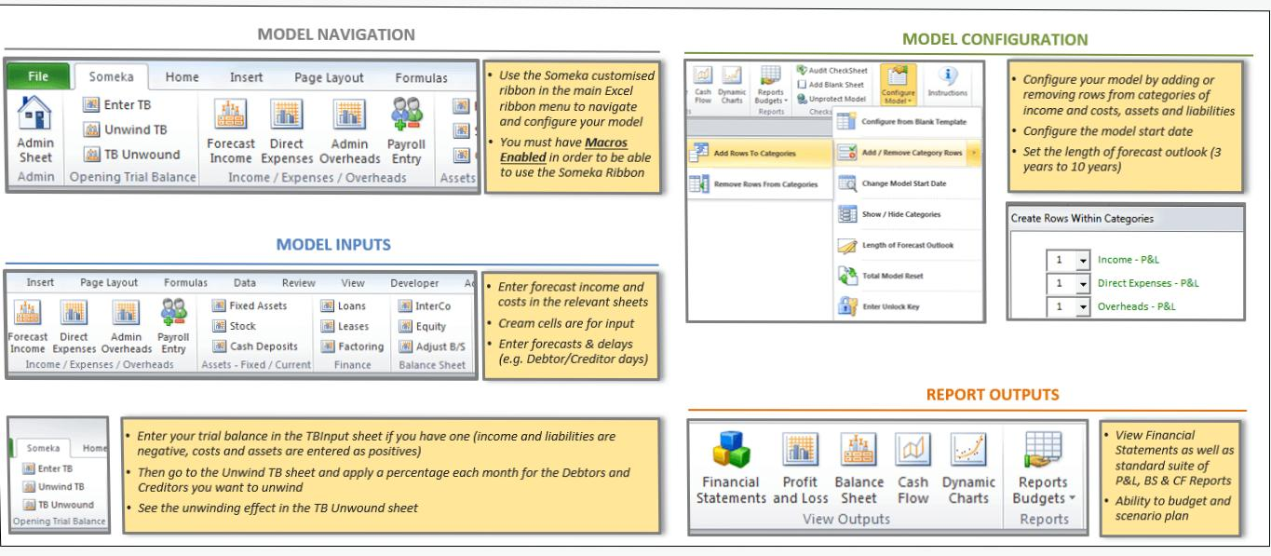
MODELLING
10

Slide 11
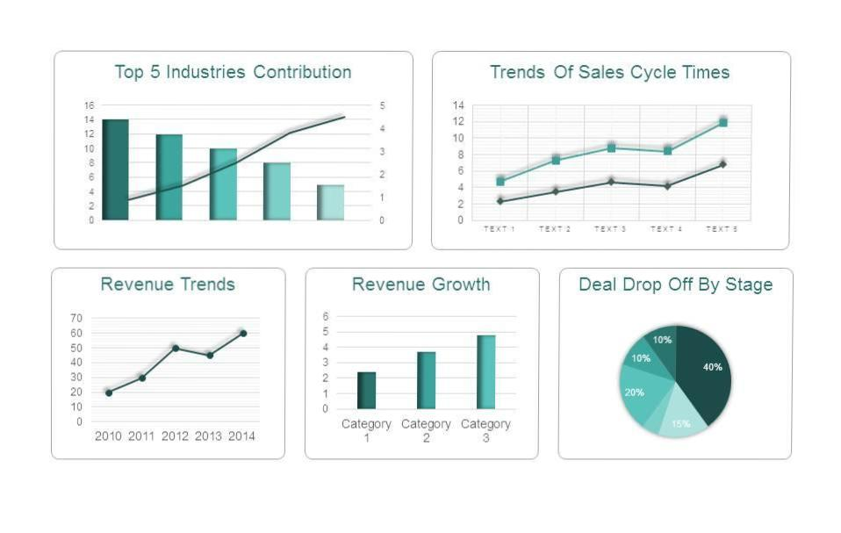
RESULTS
11

Slide 12
Conclusion
Financial forecasting is the process of projection usually involving the projection of future income and expenses can be used to help make decisions about where to allocate resources and how much money to borrow.
financial forecasting is a vital component of business planning, helping companies set goals, allocate resources, and manage risks effectively.
One common method is trend analysis, which looks at outcomes.
Ultimately, financial forecasting is a complex process that requires a mix of statistical analysis, judgment, and experience.

